Slide 1
KITAAB
Books Trading application for Santa Clara community

Slide 2
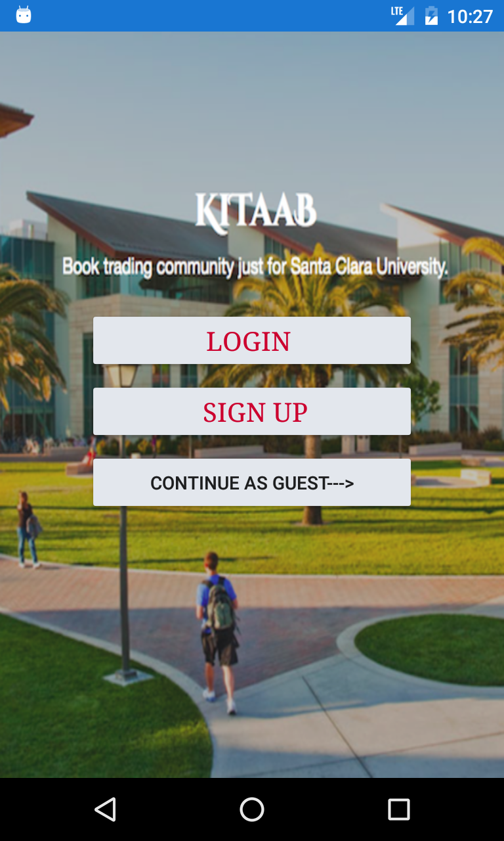
Introduction
Objective
To provide a platform where students can exchange/sell their old books.
Why Kitaab?
Users
Students, staff and faculty of SCU.
Users can buy and sell books, or both.
Guest User
Anyone who has downloaded the application.
Can view the Books available throughout.
Unable to the see seller information.

Slide 3
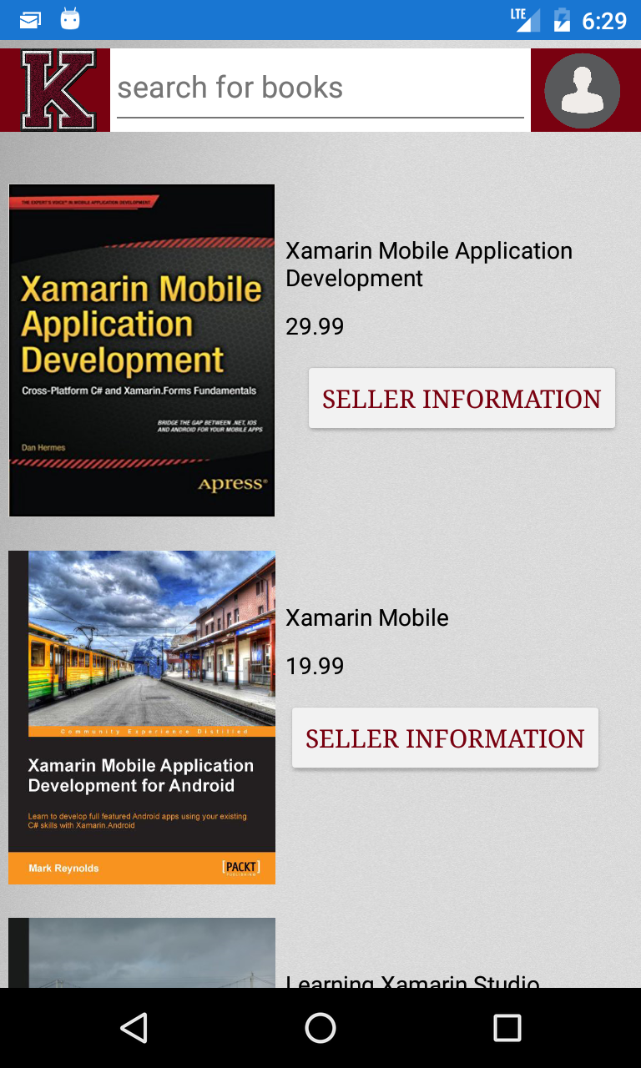
Books Selling Page
The most important page of the application. It lists all the Books published via our application.
Kitaab logo on the left navigates user to the current(Books selling ) page.
User logo on the right navigates to the user account if logged in.
The Search bar at the top filters the results based on the occurrence of the searched input in the Book’s title.
Seller information available only if you are signed in.
Seller information button will redirect to login page if not signed in.

Slide 4
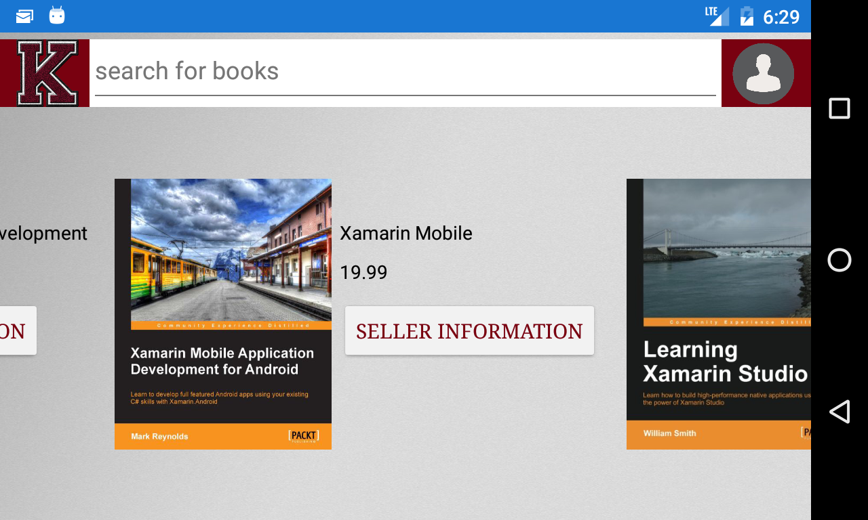
Books Selling Landscape view
The application renders different view for landscape mode. The books are now placed horizontally for a smooth and intuitive user experience.

Slide 5
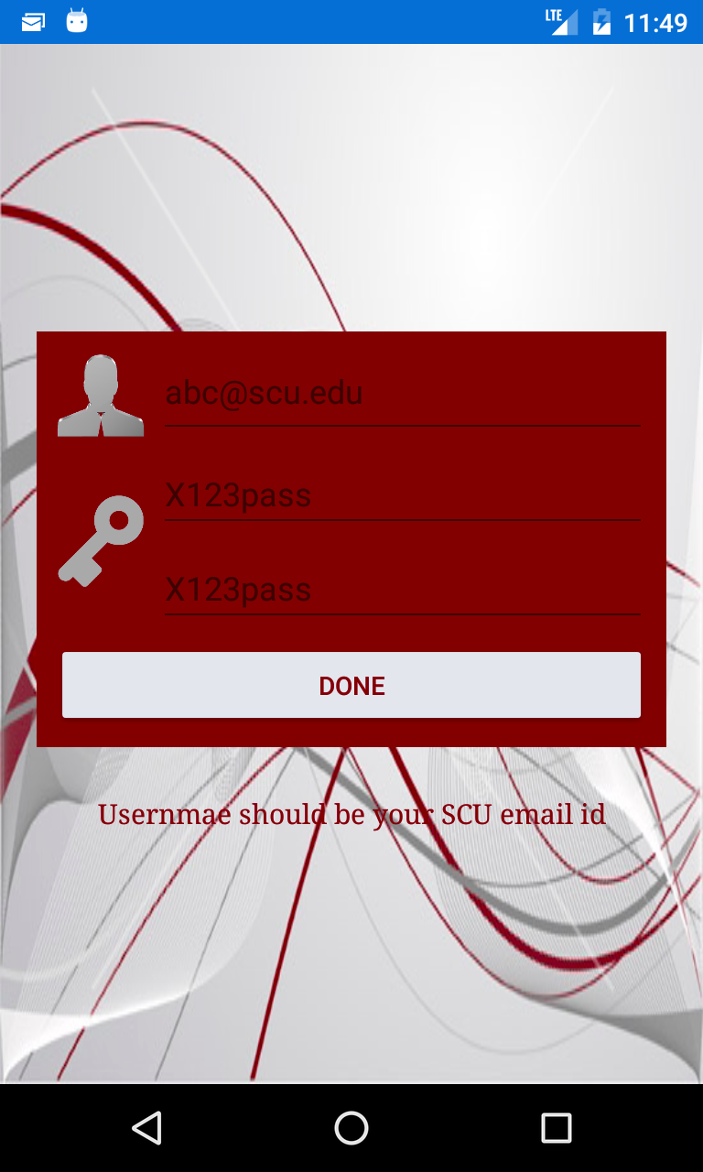
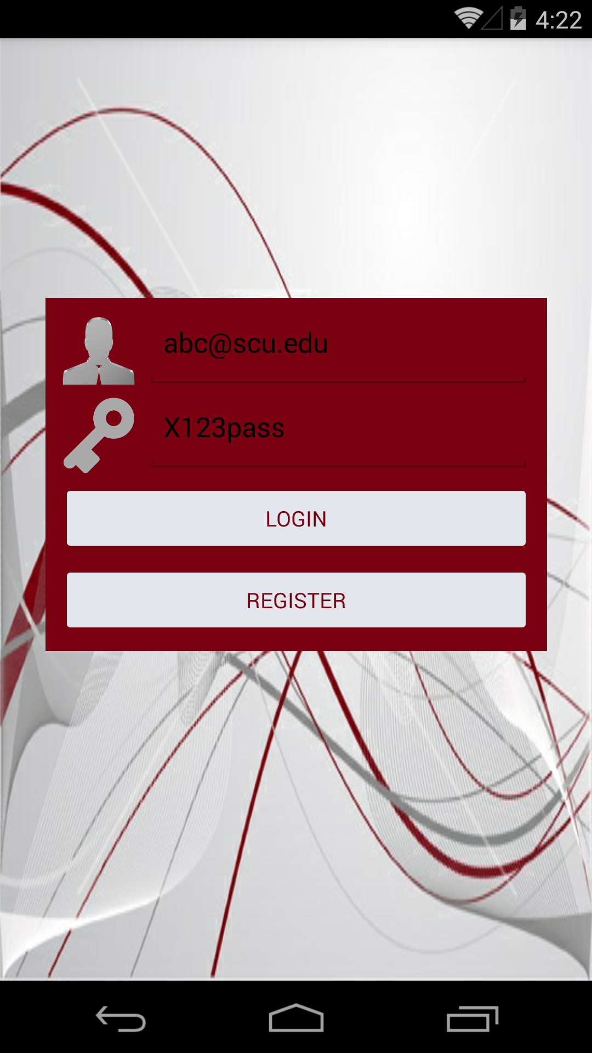
Sign up and Login Page
As soon as the user enters an email address, the application checks and prompts if an @scu.edu email is not entered.
The username verification is done before entering the password field(s). Thus, saving the effort of entering the password again and again.
Password verification and validation during SignUp and Login.

Slide 6
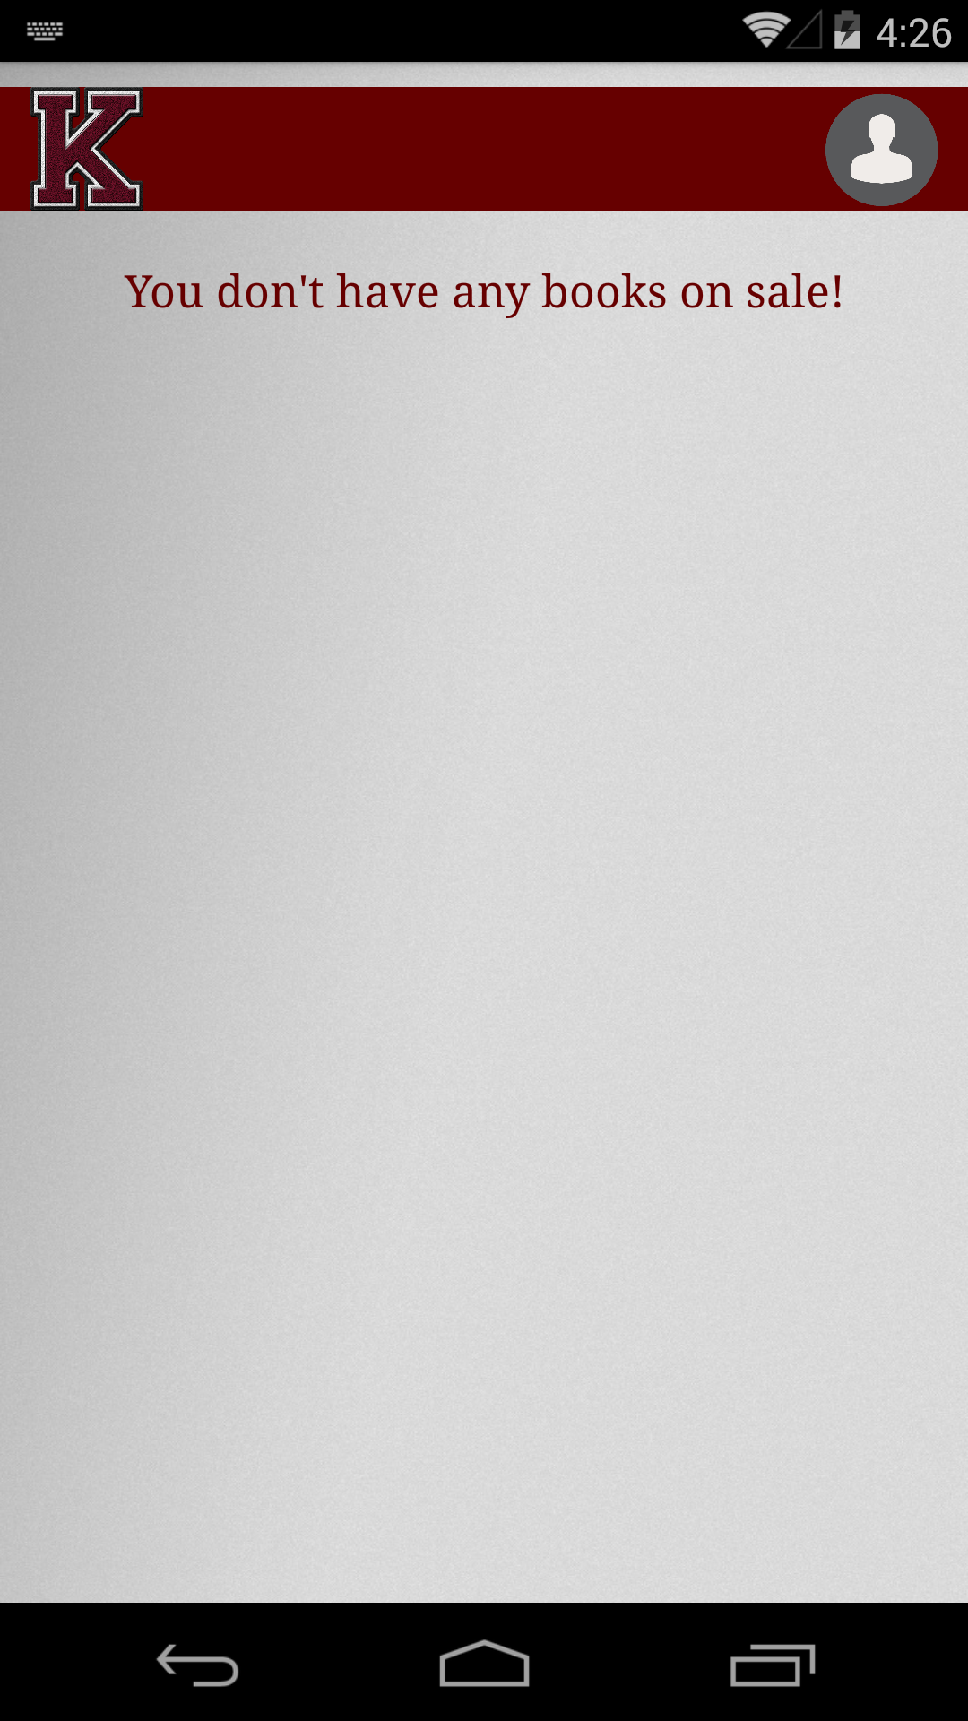
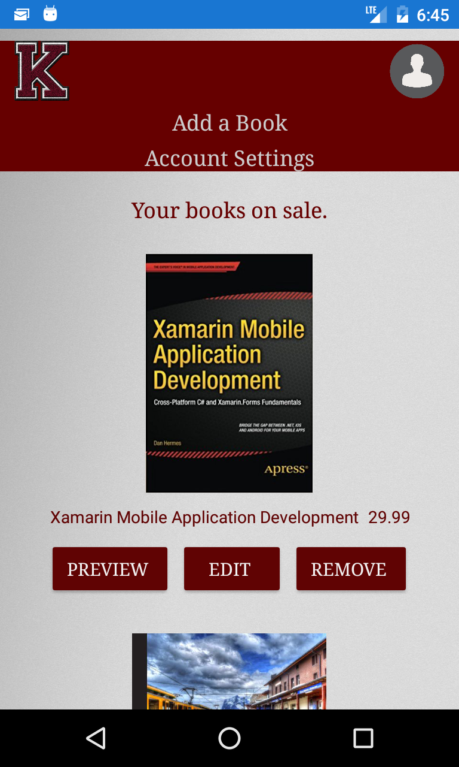
My page
This is the landing page, once the user is signed in.
New User has an empty My Books page. A seasoned user’s My page dynamically displays the list of uploaded books.
User Logo button on the top right acts as a navigation button and when clicked, provides an option for the user to either goto Account Settings or Add Books Page.
User can Preview his listing, Edit current information or Delete the book
Kitaab logo, on the other hand will redirect the user to the books selling page.

Slide 7
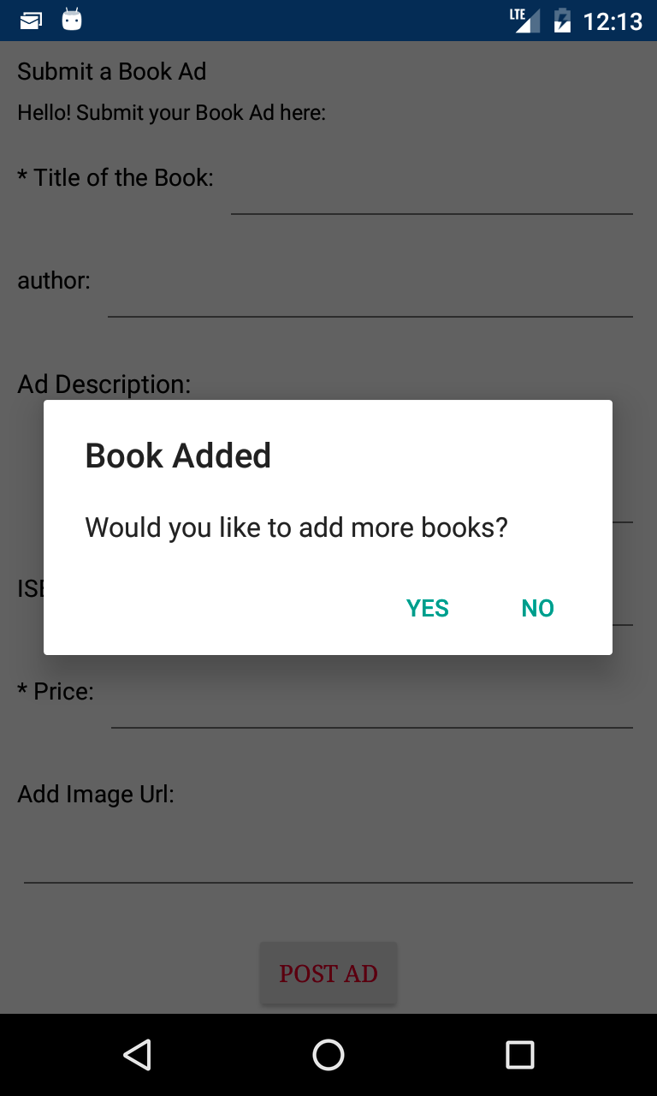
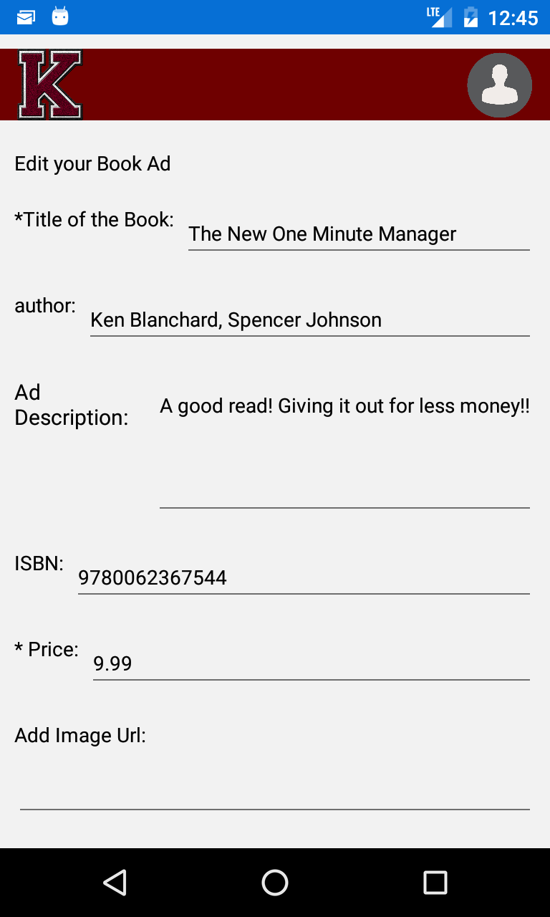
Add a Book/ Edit Book page
Allows the user to submit a book with a mandatory title, price and other optional information.
There is a check to see whether the price entered is a valid number and url entered is a valid url.
Images can be uploaded via a Url. If N/A, then the application provides a Default Image
User gets an alert to add more books, if he chooses not to he’ll be redirected to My books page where he can see his recent submission(s).
Edit Book Page will show listing with pre-filled information, which can be edited and saved.

Slide 8
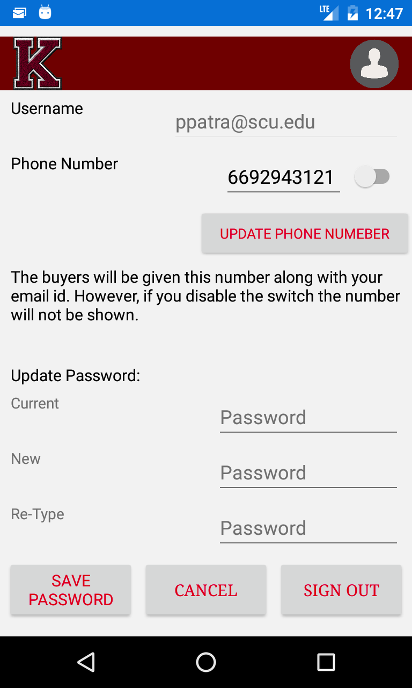
Account settings
Shows username - which can’t be edited and specifies the email address through which the user is logged in.
Phone number and a switch allows the user to display the phone no. next to their submitted books.
Password update field - Verification process for the correct current and new/Re-type password fields.
Sign out - in a way hidden to encourage users to remain logged in.

Slide 9
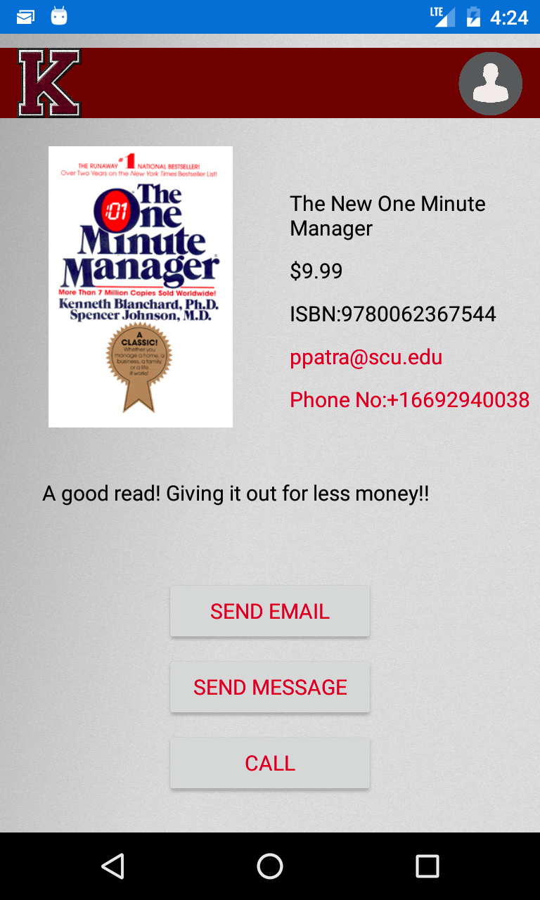
Seller Information
The most resourceful page of the application.
The page is accessible to the user, if logged in.
The buyer then has the ability to contact seller directly via email. In addition, a phone number - if provided or enabled by the seller.
Displays the ad description and information submitted by the seller.
The Send Email button leads to your Mail application with pre filled info ready to be sent to the seller.
The next option only available, if there’s a phone number displayed:
The Send Message button/ Call button redirects to your message/ call application.

Slide 10
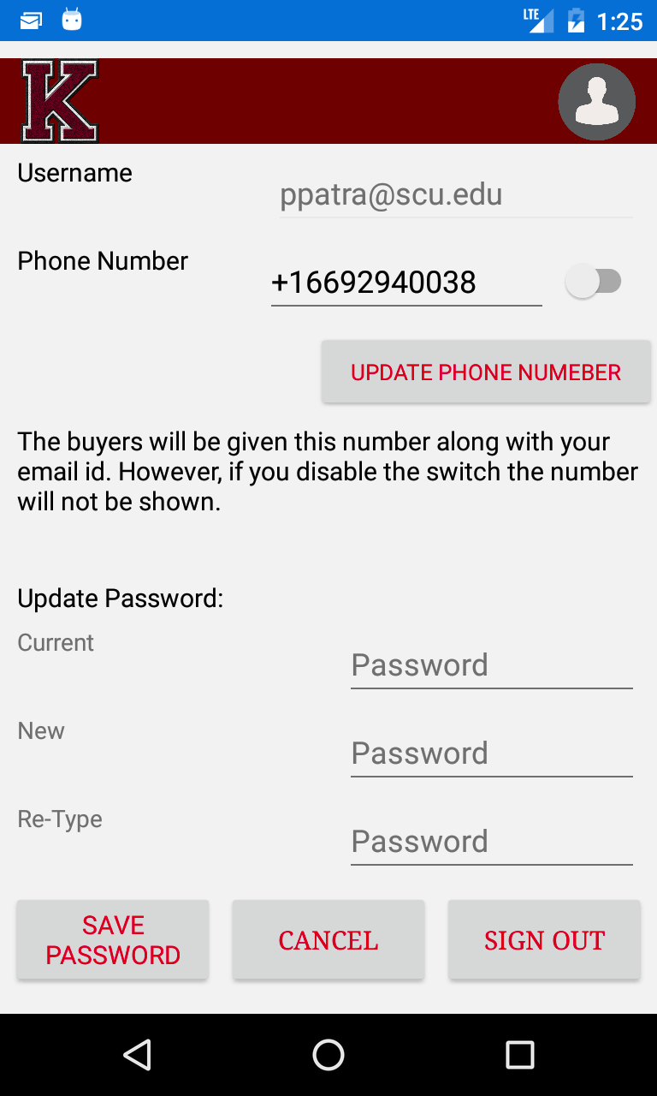
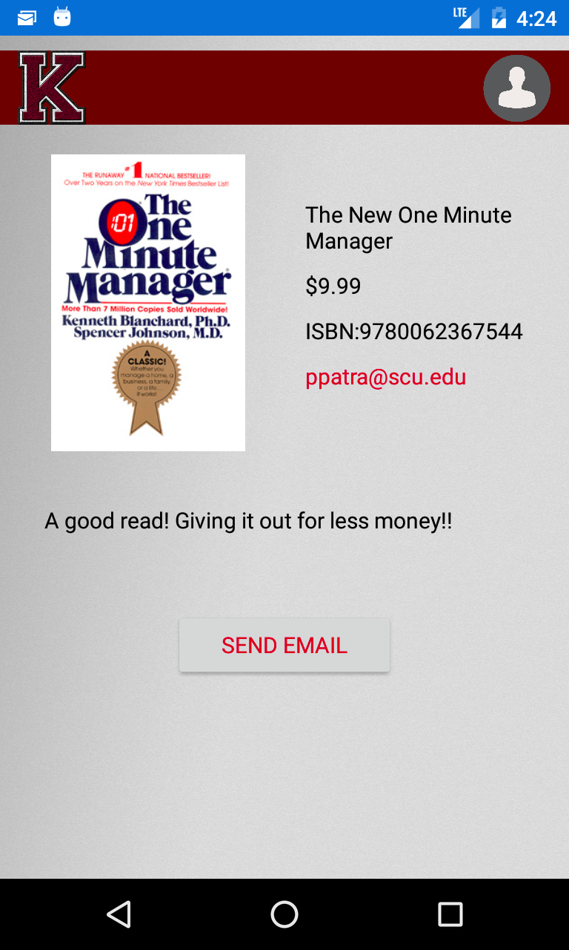

Slide 11

Thank You from Team Kitaab
Bhumika Gupta
Vidur Chanana

